Slide 1
Web Development

Slide 2
Requirements
Download & Install Docker Desktop
Download & Install Visual Studio Code
Create Github.com account

Slide 3
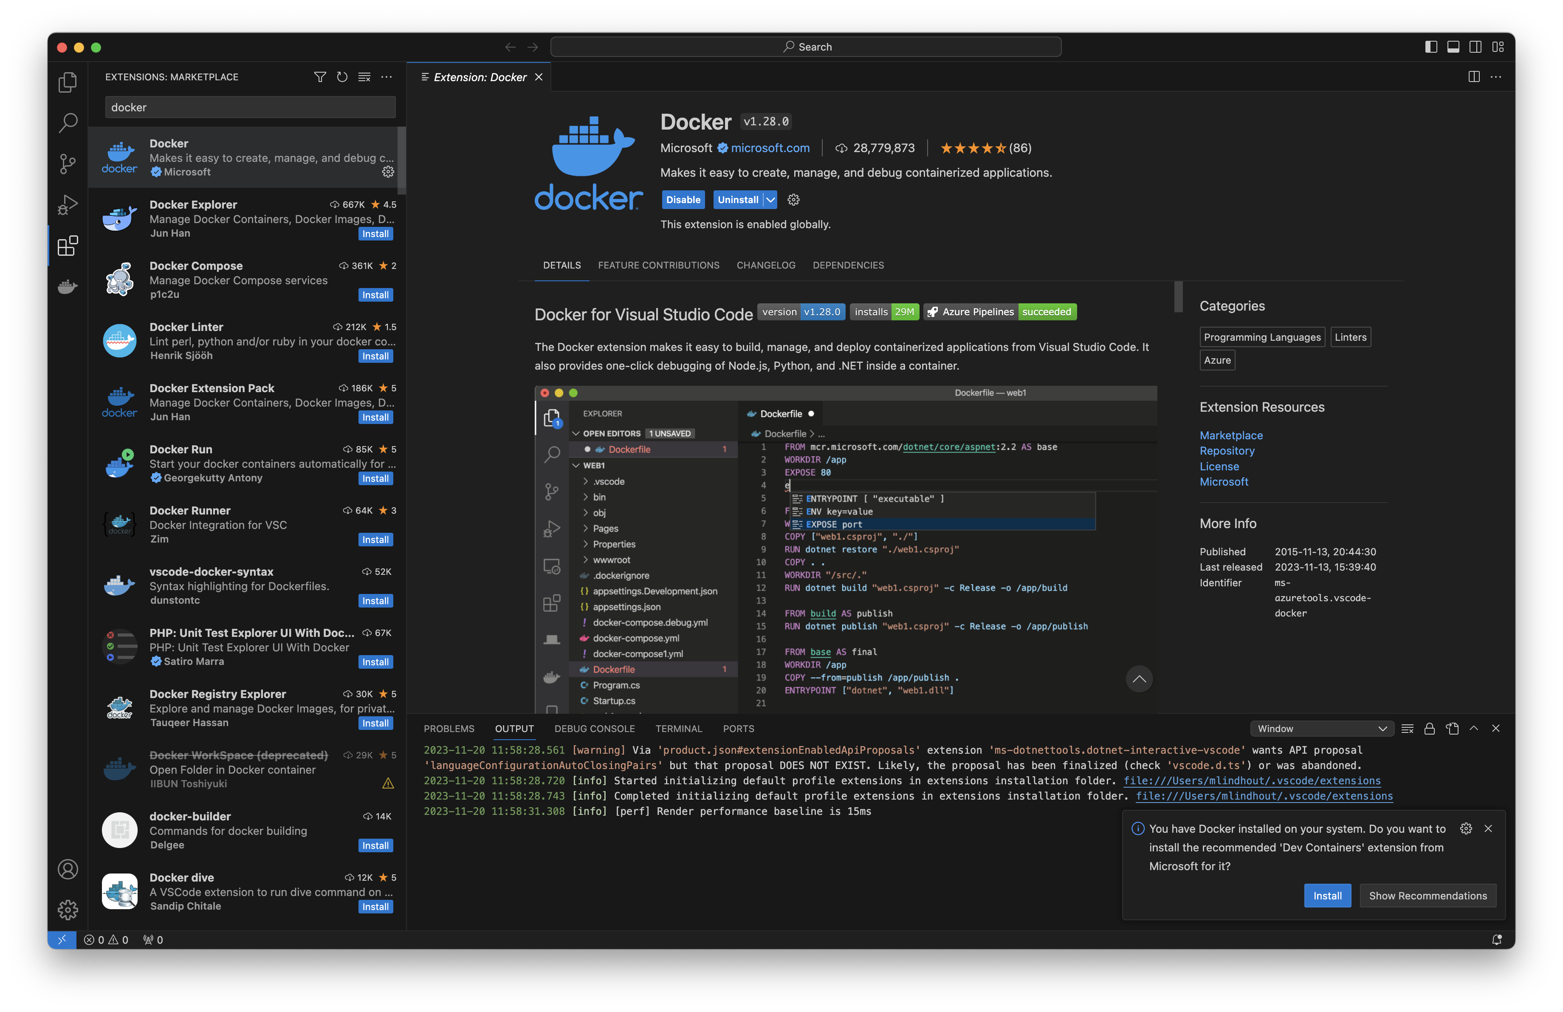
Docker plugin
On the toolbar, click on ‘Extensions’
Search for ‘Docker’ and click ‘install’

Slide 4
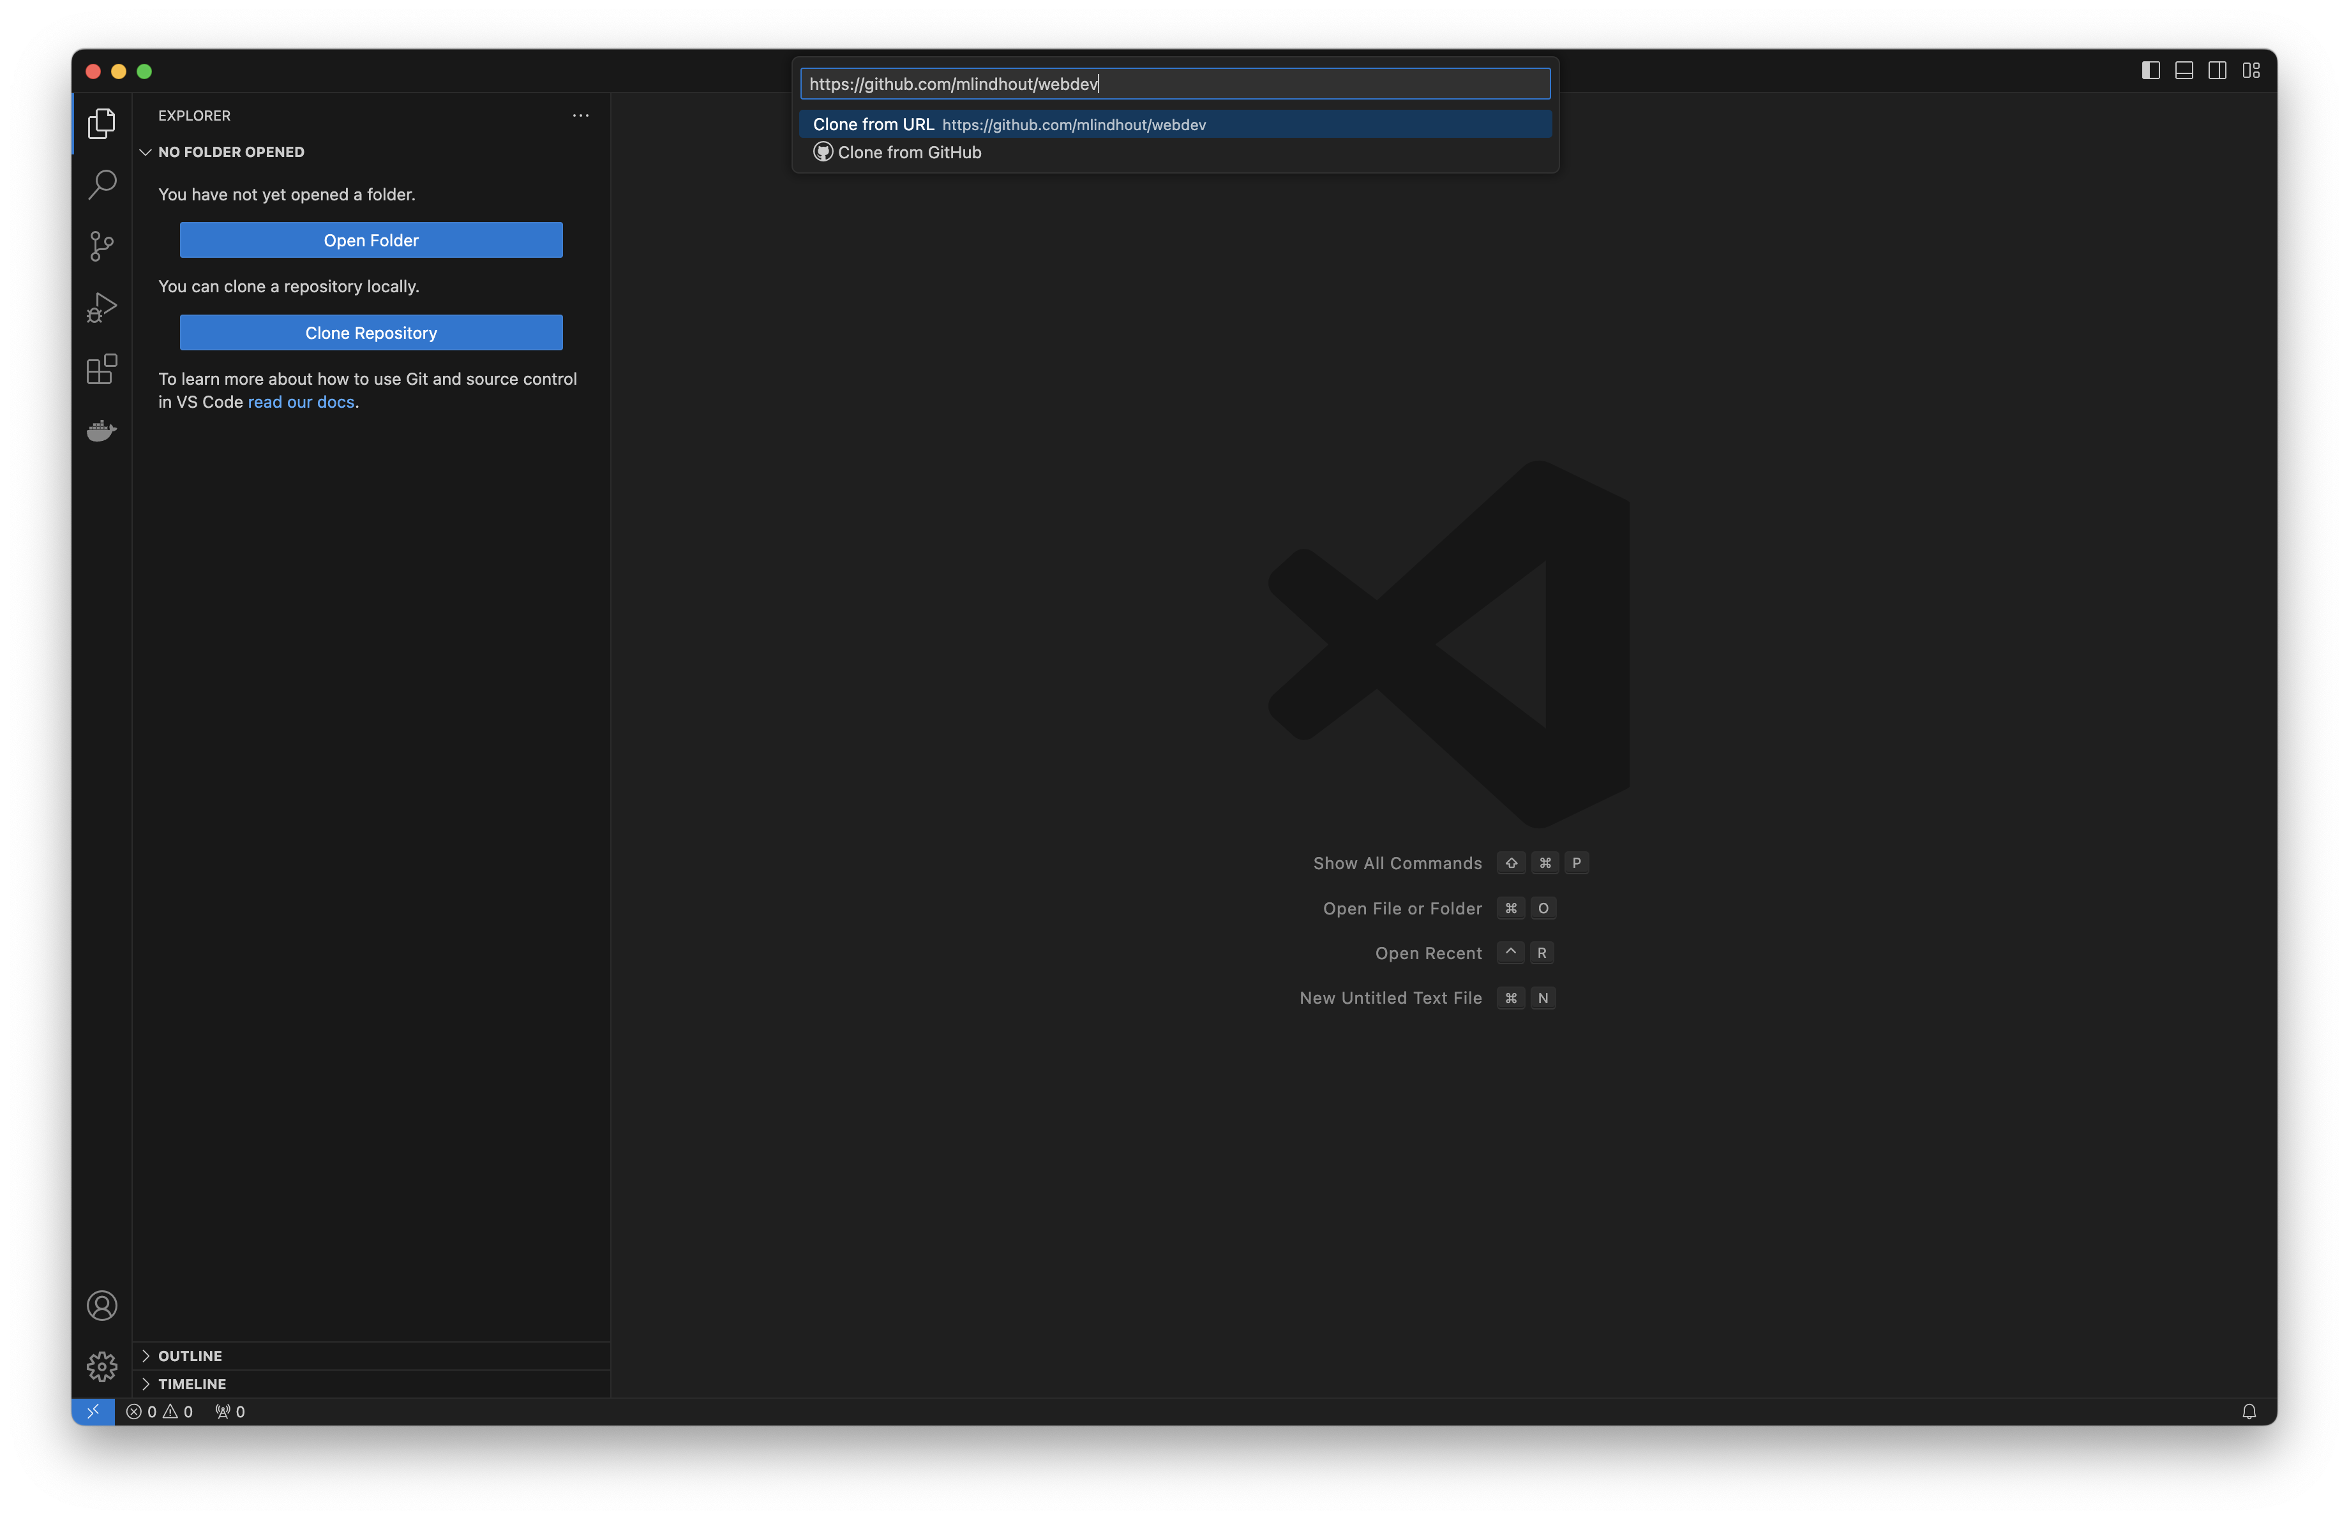
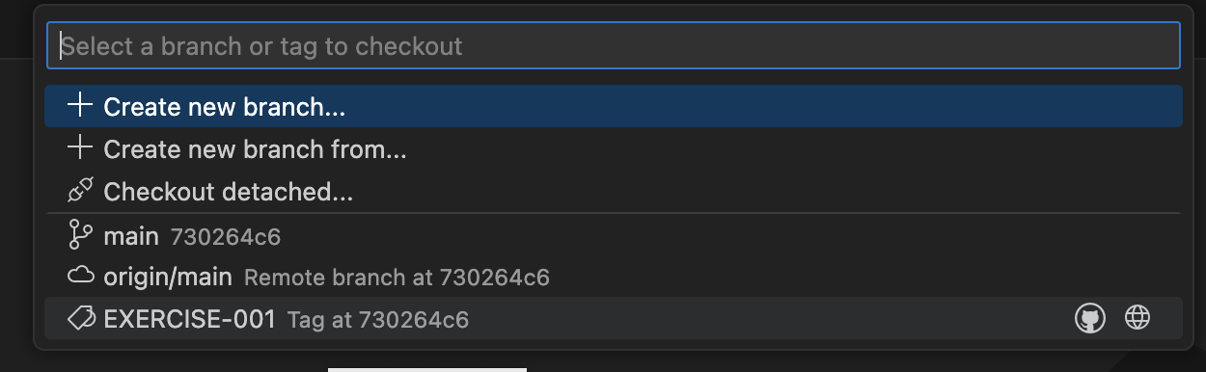
Clone repository & checkout tag
On the toolbar, click on ‘Explorer’, then, ‘Clone Repository’
Enter ‘https://github.com/mlindhout/webdev’
Click on ‘Open’ when asked to open window
In the left lower corner, click on main
Then, in the top, select EXERCISE-001
Check that the left lower corner now contains ‘EXERCISE-001’.

Slide 5
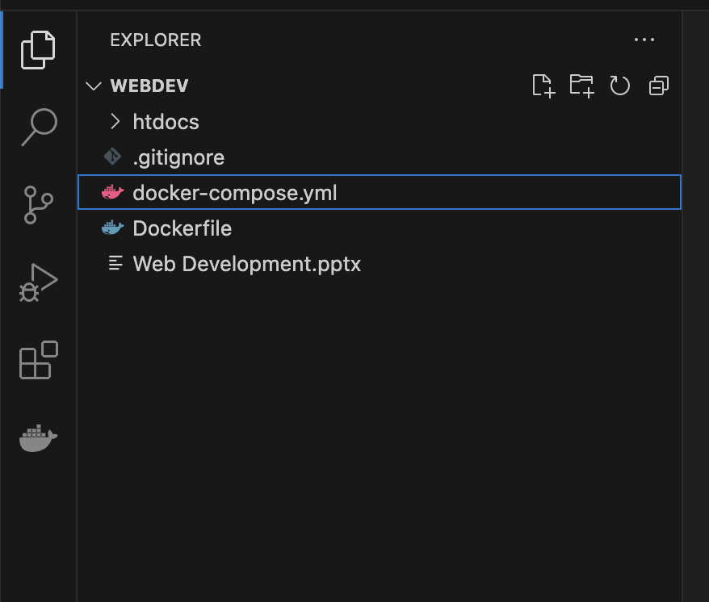
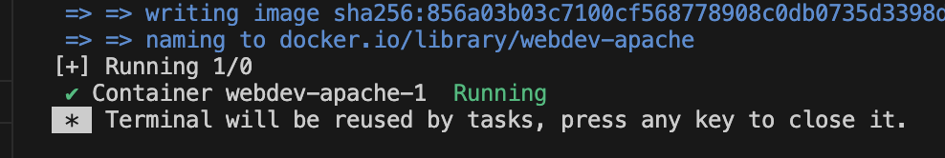
Start the webserver with Docker
In the Explorer, left-click on docker-compose.yml and choose ‘Compose Up’
Notice what happens and wait for the green ‘Running’ message
Open http://localhost in your browser
You should see a message ‘Hello, world!’

Slide 6
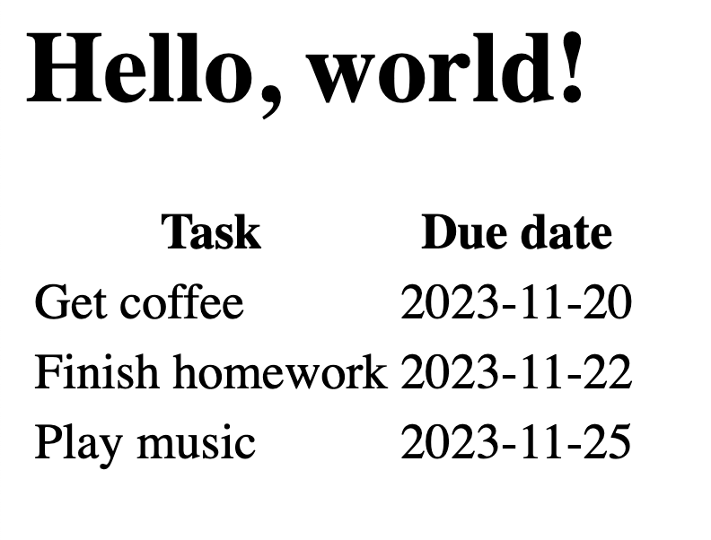
Exercise 001
Modify the file index.html:
- add a table with two columns and 3 rows
- make the column headings bold
Learning resources
https://www.w3schools.com/html/html_intro.asp
https://www.w3schools.com/html/html_basic.asp
https://www.w3schools.com/html/html_elements.asp
https://www.w3schools.com/html/html_attributes.asp
https://www.w3schools.com/html/html_tables.asp

Slide 7


What happened?
With ‘Compose Up’, you started a webserver with the name localhost.
With the URL http://localhost, you told your browser to retrieve the page located at the root of that server
The server returned the default file index.html with the HTML tags in it.
The browser transformed the tags in a table with the todo items.
GET http://localhost
<html>….</html>

Slide 8
Url, hosts, pages,
http :// bbc.co.uk / article / some-interesting-article.html ? foo=bar&mode=xyz
Protocol
(or scheme)
Host
(or server
or domain)
Path
Query parameters
Nr. | URL | Result
1 | http://localhost | Same as 2
2 | http://localhost/ | Request the default path at the root of the server named localhost. Most servers will reply with the file named index.html or index.php.
3 | http://localhost/index.html | Request the file index.html at the root of the server (effectively the same as 2)
4 | http://localhost/user/profile.html | Request the file profile.html in the folder user at the server named localhost.
5 | http://bbc.co.uk/weather/today | Request a file named today in the folder weather at the server bbc.co.uk.

Slide 9
HTML – HyperText Markup Language
A standard HTML file is static
Meaning it stays the same until you modify it by hand
When asked, the server just returns the file
It is always the same result, for everyone
For example with HTML, you can’t display the current time
Because the time changes each second (and thus each request)
To do this, you need a dynamic language, like PHP
With a dynamic language, you can change the content of the HTML

Slide 10
PHP – PHP HyperText Preprocessor
When the server gets a request for a .php file, it asks PHP to ‘process’ the file
A PHP file contains instructions and HTML
PHP executes the instructions in the file and return the output to the server
Most of the time, this output is HTML (but can be otherwise)
The server will send the output to the browser

Slide 11
Exercise 002
Alongside index.html, create a file time.php
Inside it, echo the current date and time
Use the date format ‘Y-m-d H:i:s’
Check the result at http://localhost/time.php
Refresh the page in the browser and check if the time changes
You made your first dynamic page!
Learning resources
https://www.w3schools.com/php/
https://www.w3schools.com/php/php_syntax.asp
https://www.w3schools.com/php/php_echo_print.asp
https://www.w3schools.com/php/php_date.asp

